Slide 1
Edge Intelligence
Turning Devices into Data Scientists
Simon Crosby
CTO
SWIM.AI Inc.
www.swim.ai

Slide 2
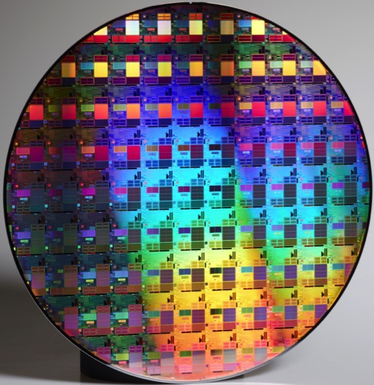
5B
cores/Q

Slide 3
5B
How will edge devices get “smart”?
Send data to the cloud?
Too much data
REST+ Big Data is too slow
Streaming data pipelines are still a mystery
Train in the cloud, inference @ edge?
Who builds the model?
How is the model distributed to the edge?
How to make models robust?
cores/Q

Slide 4
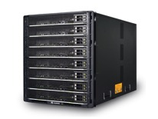
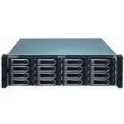
Big Data or Big Mistake?
+
70 samples per ゜x 360゜x 1000 RPM
For 360 days/year
> 1,000 PB / year
x 40 Compressors
Goal: 0.5% increased ROI per year on $1B CapEx
Custom Logger

Slide 5
The Intelligent Edge…
Analyzes, learns & predicts from time-series data, on-the-fly
Builds a stateful digital twin model of the real-world from streaming data
Twins collaborate to analyze, learn & predict in real-time
Delivers real-time insights via UIs / streaming APIs

Slide 6
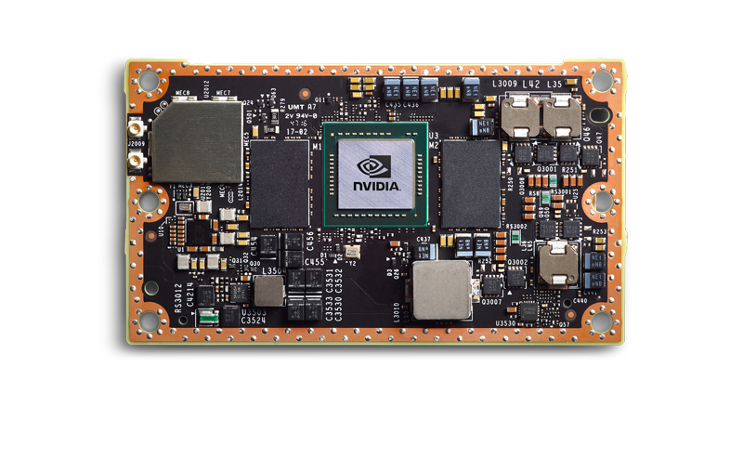
We only need this…
$200
Quad ARM® A57/2 MB L2
NVIDIA Pascal™, 256 CUDA cores
NVIDIA Jetson TX2

Slide 7
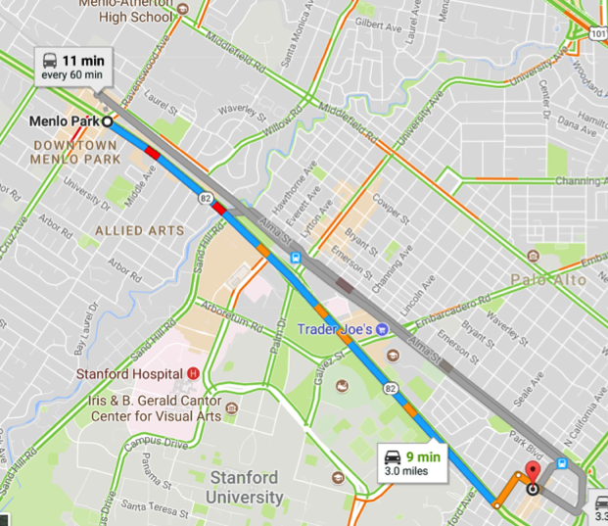
…to route vehicles through a city without stops…
Processing 4TB / day @ edge
vs $5,000/month in the cloud
Enabling a new market for insights

Slide 8
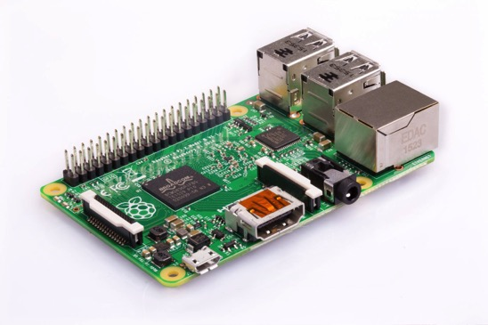
And…
$90
To track & map millions of RFID tags in real-time
With 70% cuts in bandwidth & storage, 50% cut in datacenter cost

Slide 9
How?
▪ Build a digital twin model of the real world directly from streaming data
▪ Digital twins collaborate to analyze, train & predict system behavior
{REST}
(λ)
vs
data
$

Slide 10
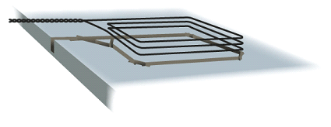
Architectural Limitations
Devices

Slide 11
Devices + Networks

Slide 12
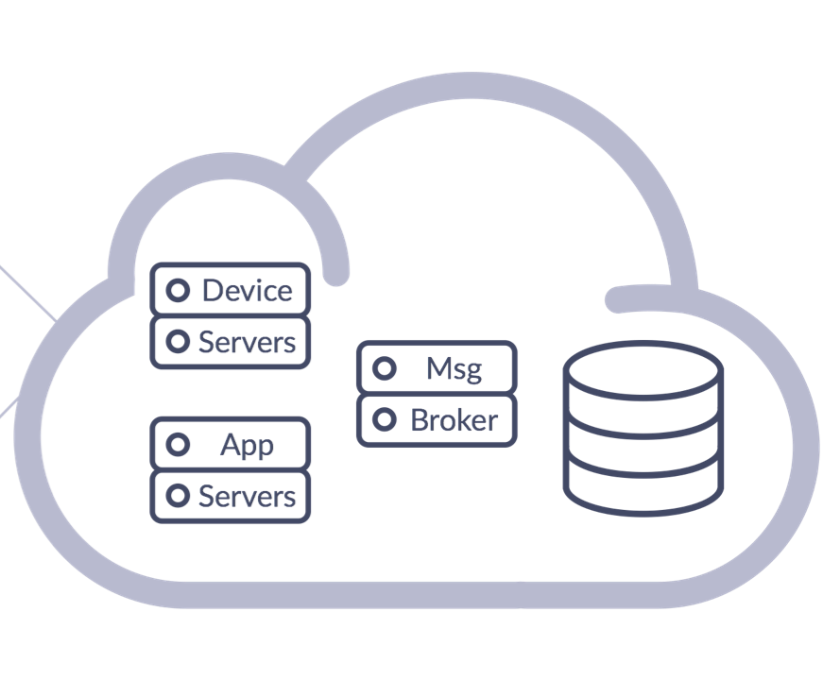
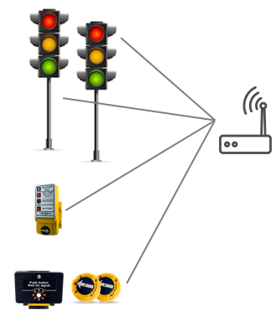
I’m red

Slide 13
I’m still red

Slide 14
…
…
I’m green
…
…
…
I’m red
…
…
…
…
…
…
…
…
…
…
…
…
…
…
…
No push
…
…
…
…
No push
…
…
…
…
…
…
…
…

Slide 15
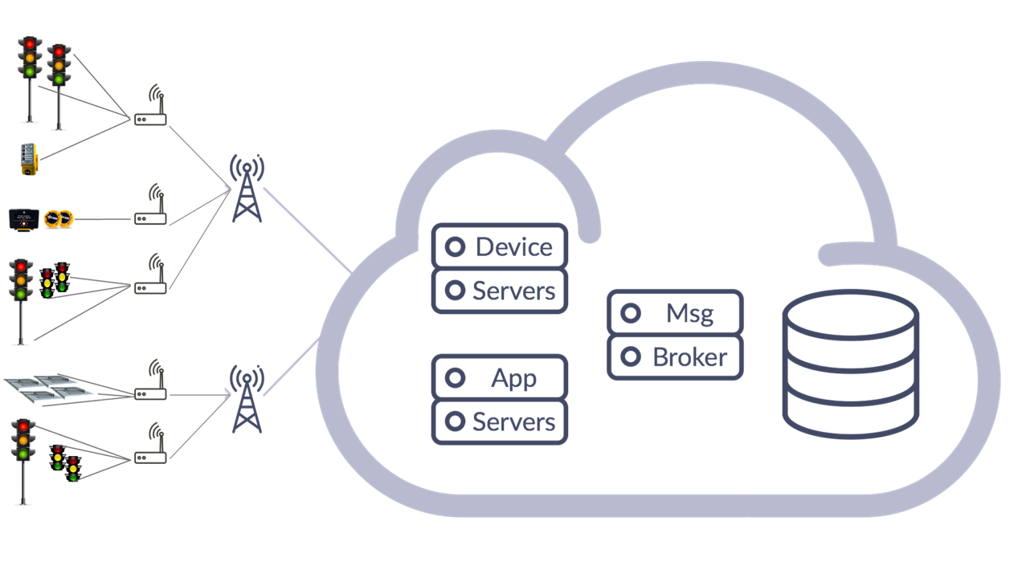
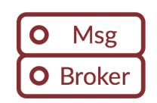
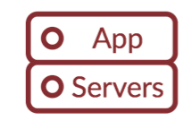
Database can't scale state changes
Broker has poor consistency model
App servers scale poorly
Networks are unreliable

Slide 16
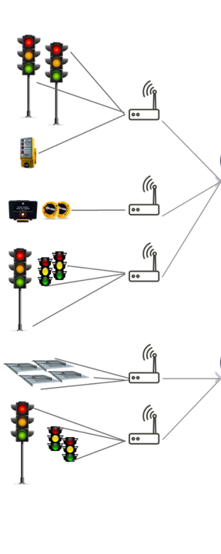
Maybe use an "edge cloud”?
One big problem becomes many new problems

Slide 17
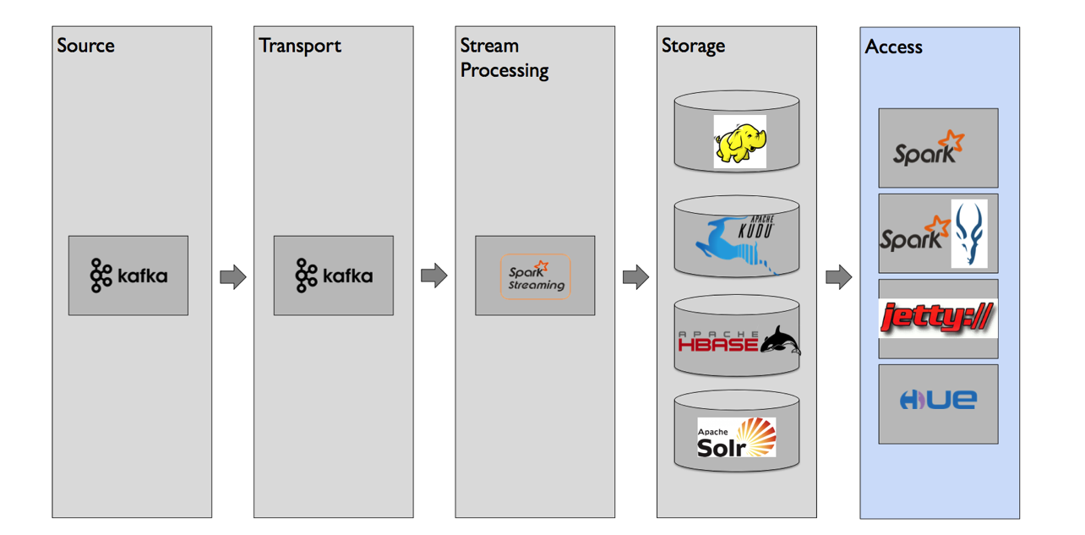

Slide 18
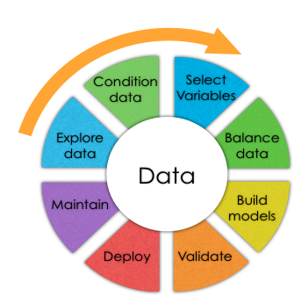
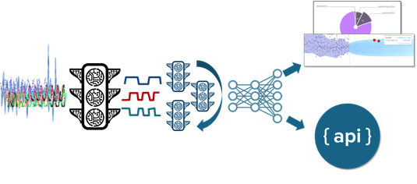
Modeling
Either
or
Let the data build the model - at the edge
Use entity relationships from the real
world to continuously analyze / learn

Slide 19
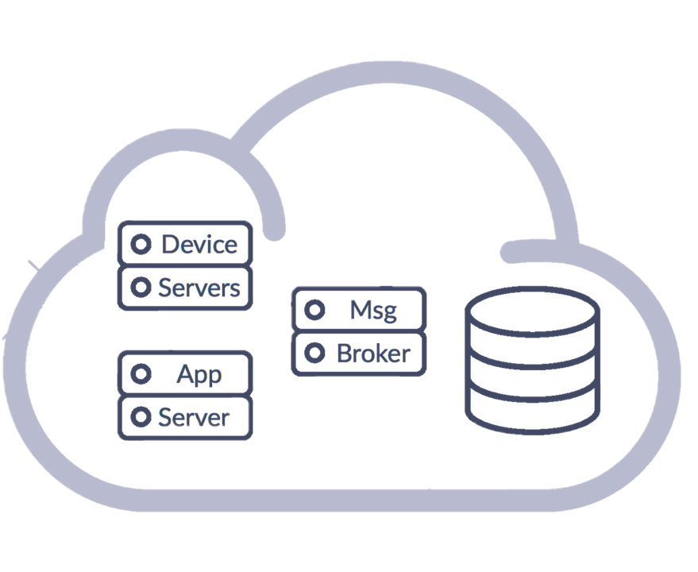
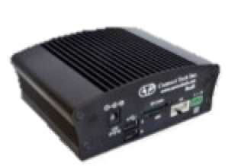
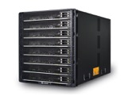
Edge Fog Cloud

Slide 20
I’m green
Digital Twin
Distributed fabric – hide infrastructure
Digital twins are instantiated from the data & statefully process their own updates, at the edge

Slide 21
I’m red
The original data can typically be discarded, or stored asynchronously

Slide 22
I’m still red
Noisy / redundant updates are quicky processed at the edge, at zero incremental cost in bandwidth/compute/storage

Slide 23
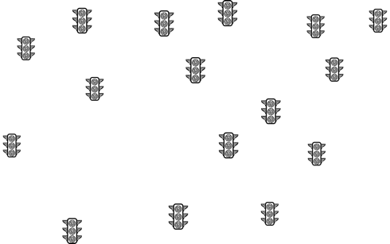
…
…
I’m green
…
…
…
I’m still red
…
…
…
…
…
…
…
…
…
…
…
…
…
…
…
No push
…
…
…
…
No push
…
…
…
…
Streaming data builds the digital twin model, efficiently, at low cost, in real time, at the edge
…
…
…
…

Slide 24
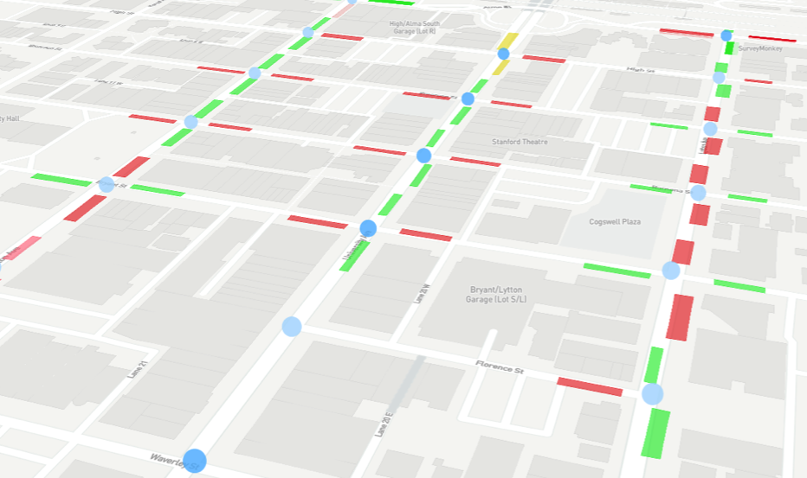
Context lets digital twins collaborate to solve complex problems

Slide 25
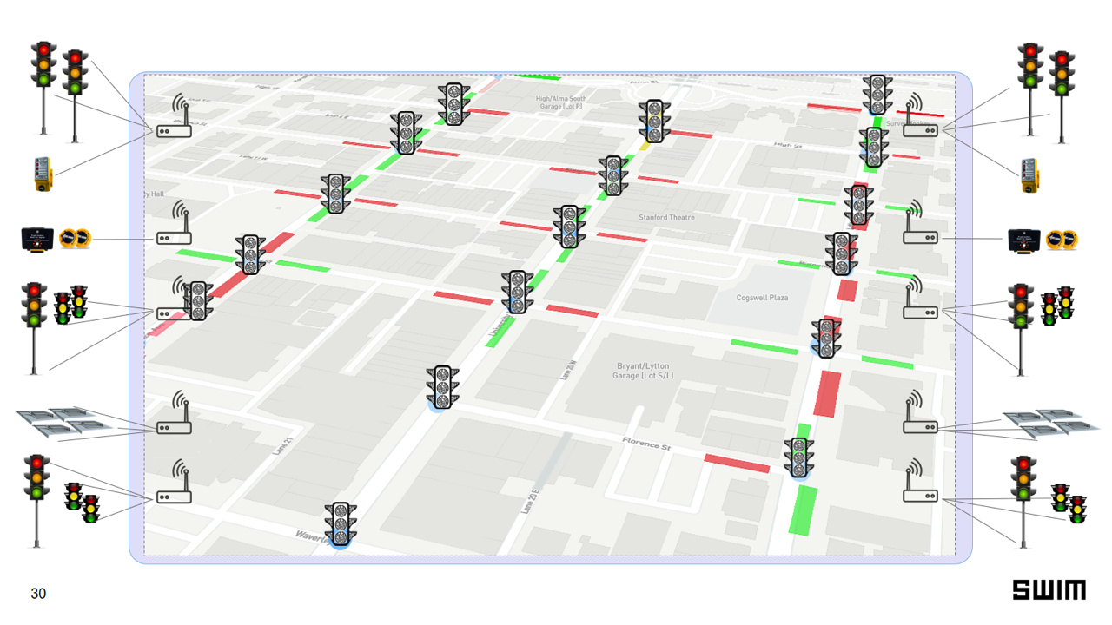
2 min
1000m
Domain experts specify simple parameters that enhance accuracy

Slide 26
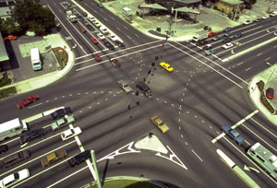
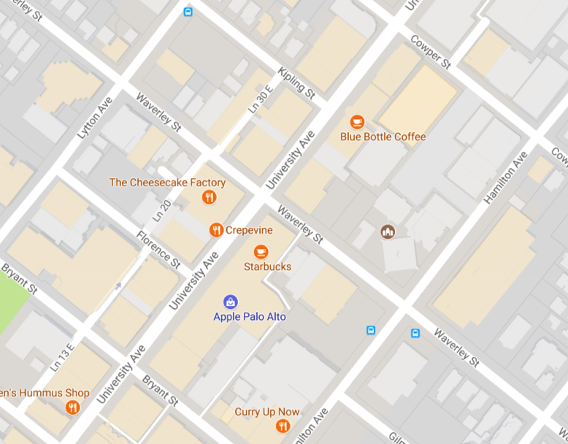
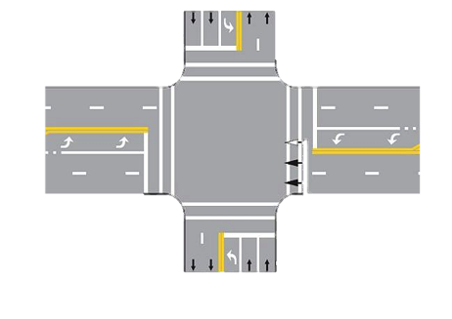
Digital Twin
Signal Data
Real World

Slide 27
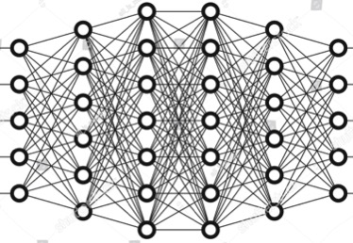
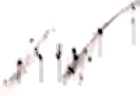
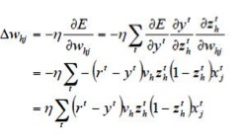
Online Training & Prediction
Observed
Predicted
Δ
Training
Back Propagation
Digital twins share data

Slide 28
Detail
Each intersection builds its own model
Enumerated values translate to densities eg {red, green, yellow} → % time in window of r/g/y
Inputs: {Local & Neighbor sensors} x time_window Typically < 3,000 inputs
3 Layer fully connected DNN predicts {Local & Neighbor sensors} x time_window
Learns about time!

Slide 29
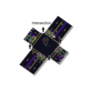
T
Intersection
Intersection
Intersection
Traffic Data
Traffic Data
Traffic Data
Signal Data
Intersection
Traffic Data
City
Traffic Data
Subscribers
Traffic Data
Intersection
Traffic Data
Intersection
Intersection

Slide 30
Summary
Use data to build digital twin models in real time
Efficient, stateful, in-memory edge processing
Twins statefully process their data & reduce volume
Twins collaborate to learn eg: using a geo-fence
Each twin solves its own “learning” problem
Twins publish insights via APIs

Slide 31
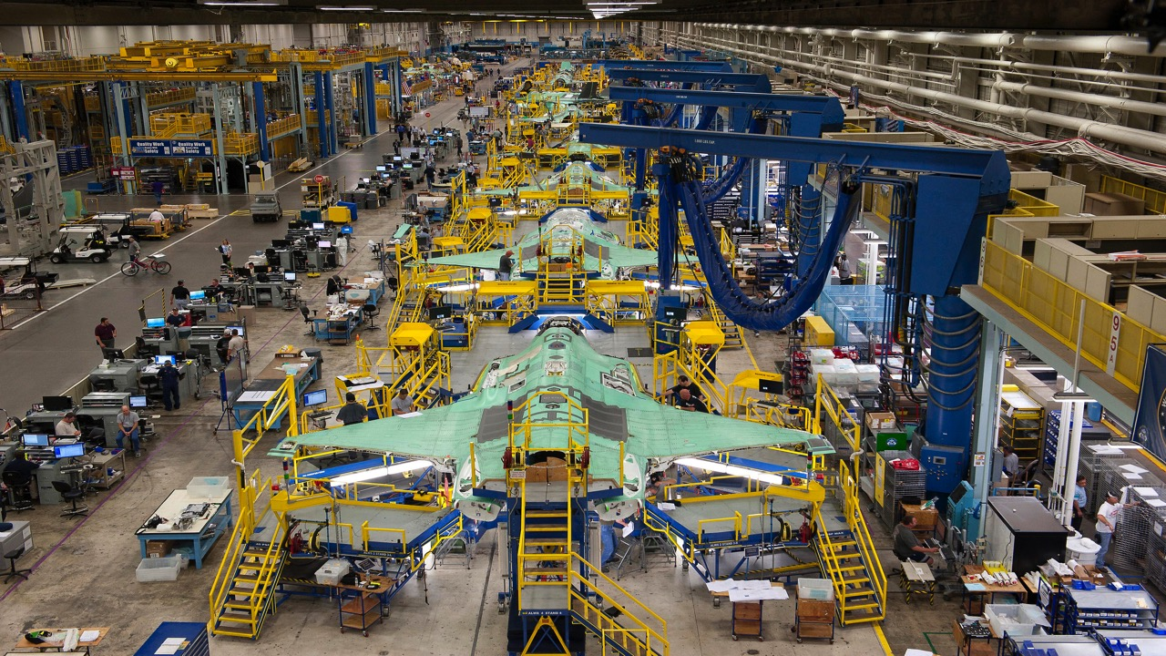
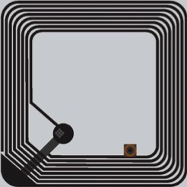
RFID

Slide 33
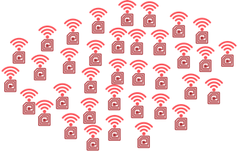
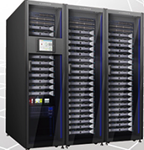
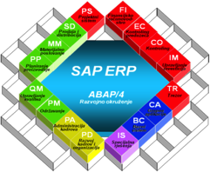
2,000 readers so ~10,000 reads / sec
Hundreds of thousands of tagged assets
Each asset gets “seen” by multiple readers
Tag read database of terabytes
Computationally intense to process

Slide 34
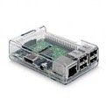
(TAG, RSSI)
Digital Twins
i_saw_you(data, RSSI)
(TAG, RSSI)
i_saw_you(data, RSSI)

Slide 35
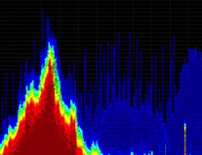
RSSI: Received Signal Strength Indicator
Signal strength variation means we need to “learn” the RF power distribution
Tag digital twin uses DeLaunay Triangulation to compute its most likely position

Slide 36
Tag digital twin has an API eg: “where_am_i()”
Smart assembly line tracks & maps tags on GUI
Geofencing around tags enables tracking of sub-assemblies

Slide 37
Summary
User defines entity relationships for the real-world & data bridges
Streaming data builds a stateful digital twin model in real-time
Twins statefully analyze their own data and reduce data volume
Digital twins collaborate to analyze, learn & predict performance
Insights are computed in real time on edge devices
.. and delivered via streaming APIs or to GUI

Slide 38
Thank You
Learn more: www.swim.ai

